Slide 1
SITE Reliability Engineering Training phase 2 – JAN 4th to Jan 29th
Topics
Dockers – recap…
microservices
Kubernetes
Ansibles, terraform, helm charts
Consul, vault
service mesh [Envoy & Istio]

Slide 2
Contents [Module 4] [Assignment 4] JAN 4th – 8th
Microservices at Scale using Dockers & Kubernetes
Microservices
Deployment using Dockers
Kubernetes
Kubernetes Deep dive
Assignment 4

Slide 3
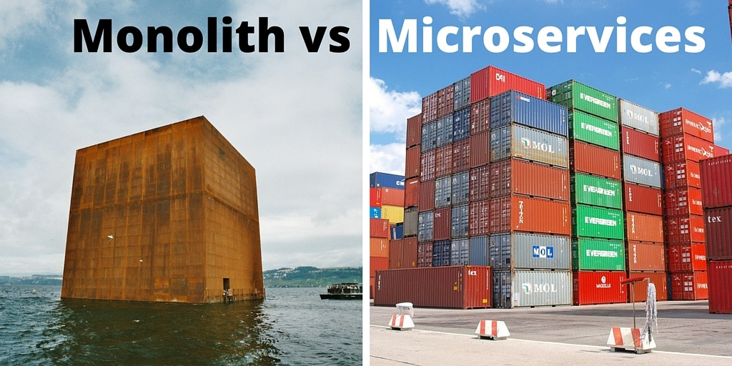
11.6. Microservice Architecture and Docker

Slide 4
Agenda
Monolithic Applications
Service Oriented Architecture (SOA)
Microservices
Docker
Gartner Hype Cycle

Slide 5
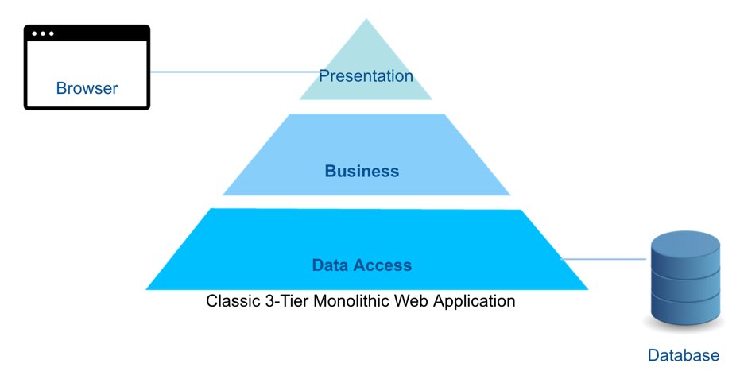
Monolithic Applications

Slide 6
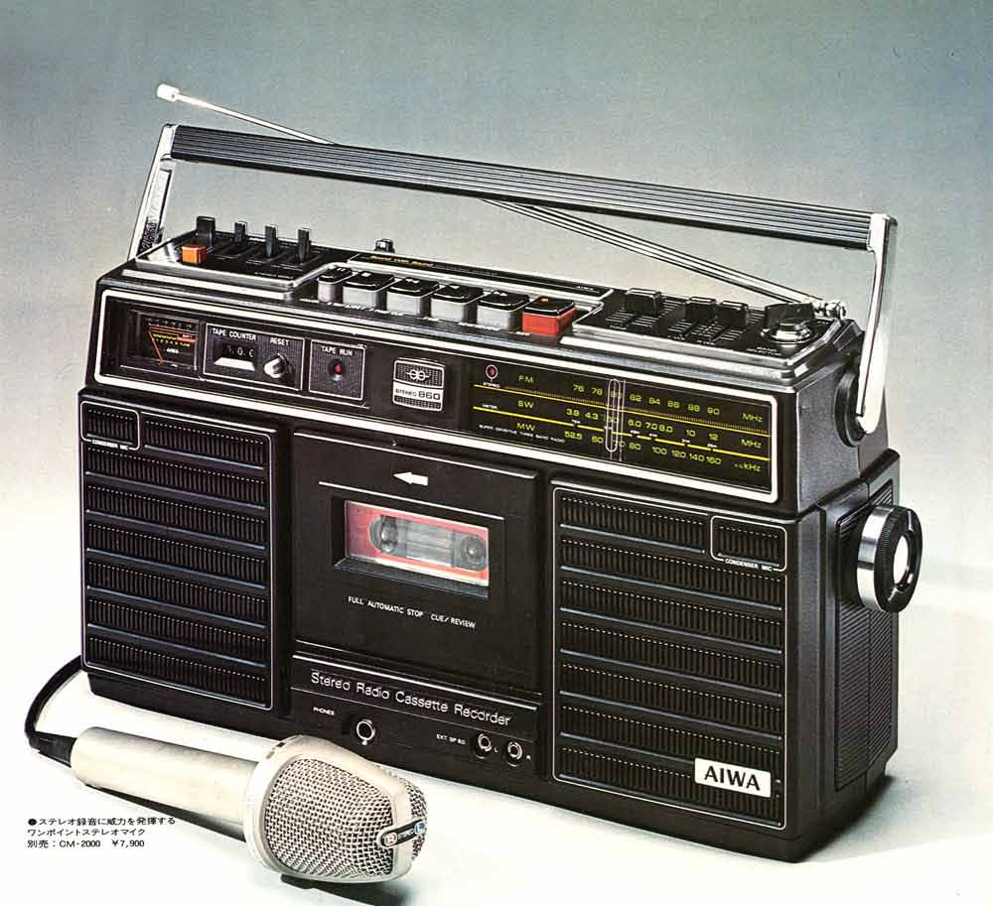
Traditional Applications:
Everything is integrated

Slide 7
But, what happens if...
We want a double cassette
Or a CD player
Or a digital radio
...

Slide 8
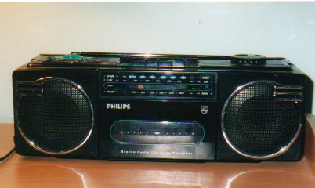
We have to change the whole thing

Slide 9
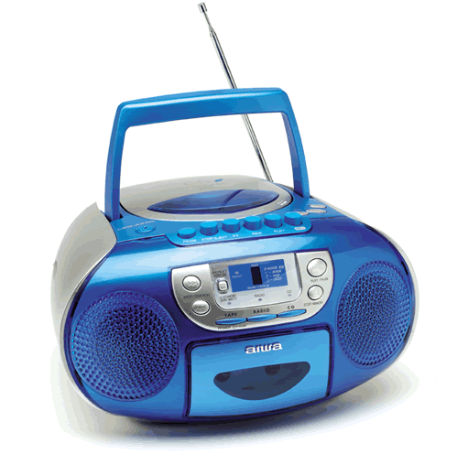
Again

Slide 10
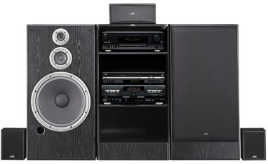
With Modular Applications

Slide 11
With Modular Applications
Each part is independent

Slide 12
Do you Need a CD Player?

Slide 13
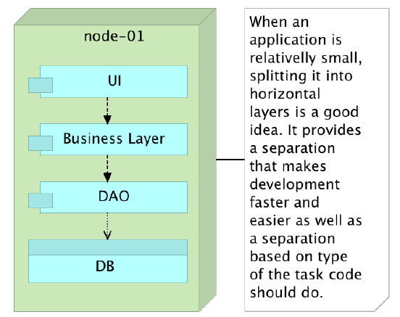
Monolithic Applications

Slide 14
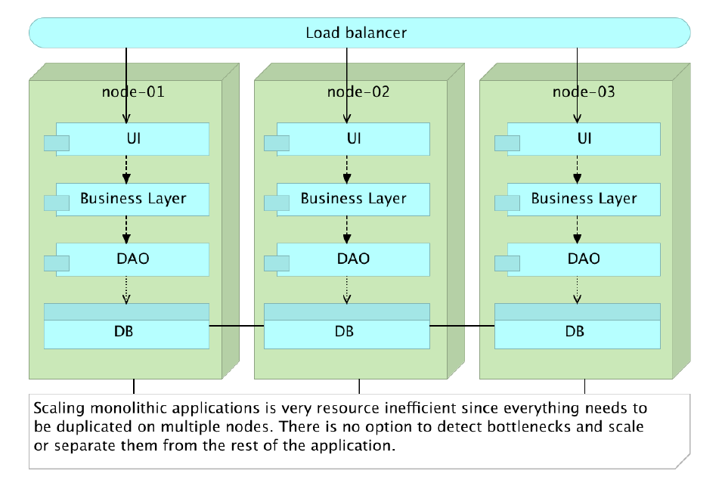
Scaling Monolithic Application

Slide 15
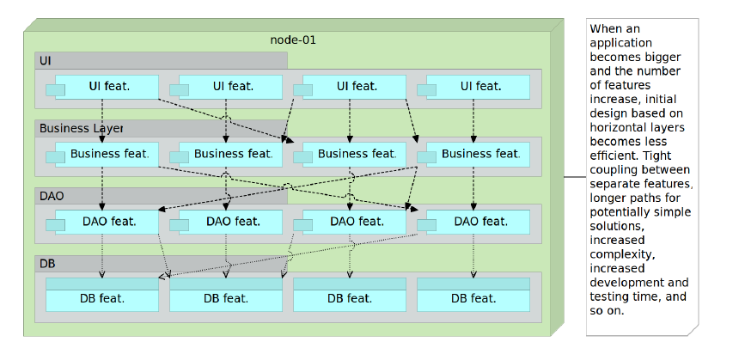
Monolithic Application with Increased Number of Features

Slide 16
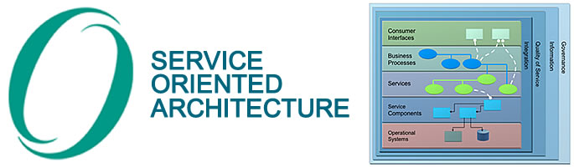
Service Oriented Architecture (SOA)

Slide 17
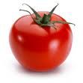


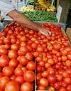
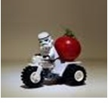
How to Buy Tomatos?
Lookup for the tomato sellers
Yellow Pages: contain companies that are selling tomatoes, their location, and contact information.
Find the service offered according to my needs
Where, when and how can I buy tomatoes?
Buy the tomatoes
Do the transaction
17
Notes:
17

Slide 18
How to Access the Service?
Lookup for the Service Provider
Registry: contain providers that are selling services, their location, and contact information.
Find the service offered according to my needs
Where, when and how can I get the service?
Access the service do the transaction
18

Slide 19
Service-Oriented Architecture (SOA):
The policies, practices, frameworks that enable application functionality to be provided and consumed as sets of services published at a granularity relevant to the service consumer.
Services can be
invoked,
published and
discovered,
and are abstracted away from the implementation using a single, standards-based form of interface.

Slide 20
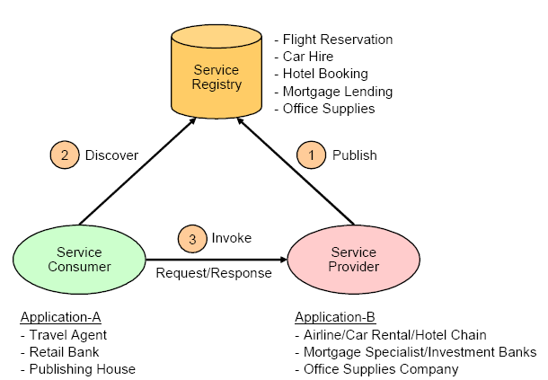
SOA Components and Operations

Slide 21
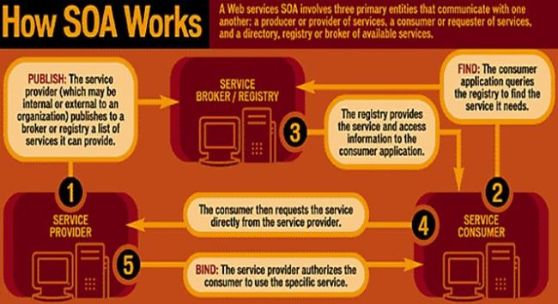
How SOA Works?

Slide 22
Broker Design Pattern Dynamics
: Client
: Client Proxy
: Broker
: Server Proxy
: Server
register_service
start_up
method (proxy)
assigned port
locate_server
server port
marshal
receive_request
unmarshal
dispatch
method (impl.)
result
marshal
receive_result
unmarshal
result
Broker tools provide the generation of necessary client & server proxies from higher level interface definitions
Interface
Specif.
Proxy
Code
Generator
22

Slide 23
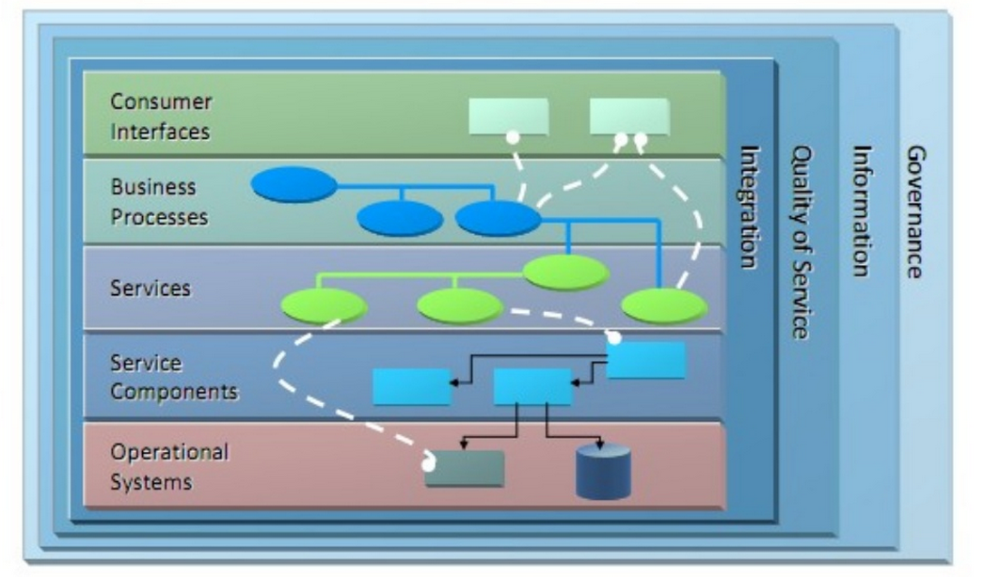
Open Group SOA Reference Architecture (SOA RA)

Slide 24
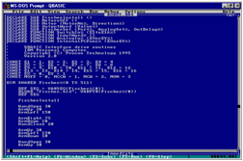
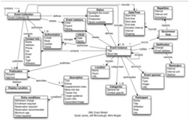
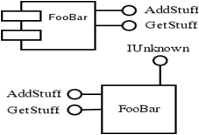
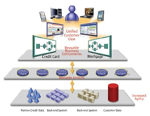
How did it come to SOA?
Object Oriented
Service Oriented
Procedural Oriented
Component Oriented

Slide 25
SOA Challenges
SOA Alphabet Soup What Would You Choose?
JBI
Axis

Slide 26
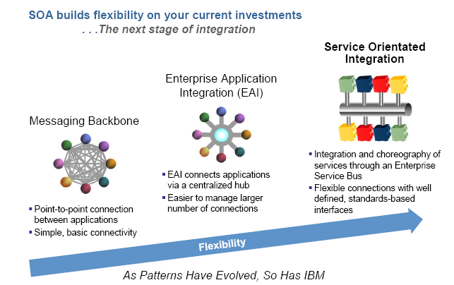
Evolution of Application Integration Patterns

Slide 27
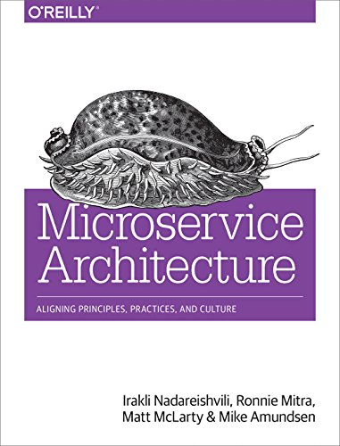
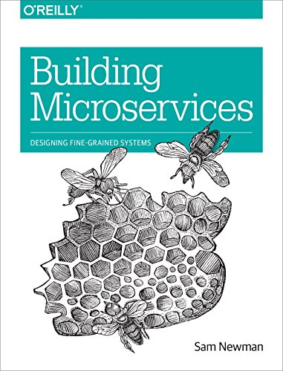
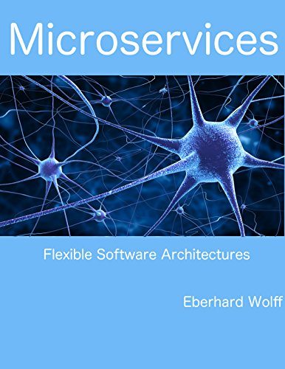
Microservices

Slide 28
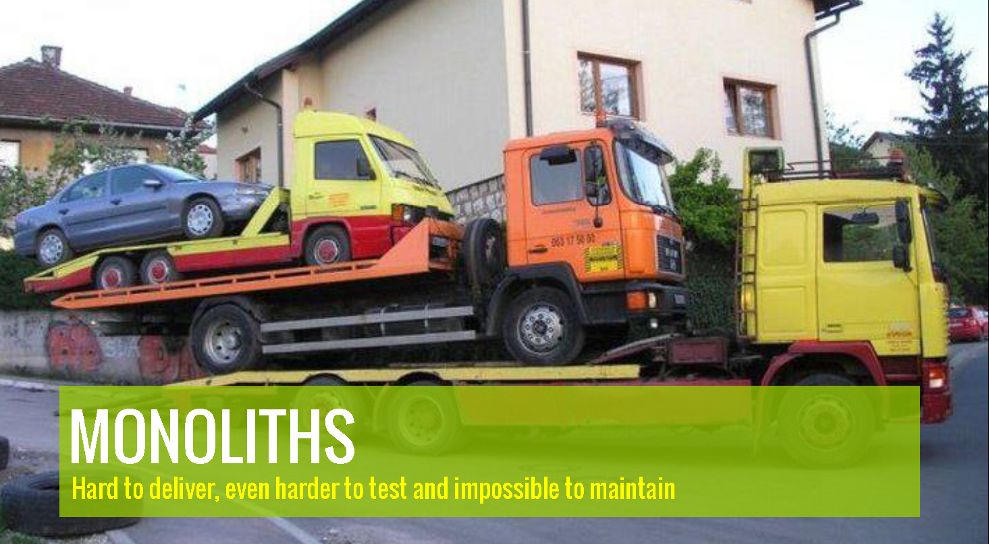

Slide 29
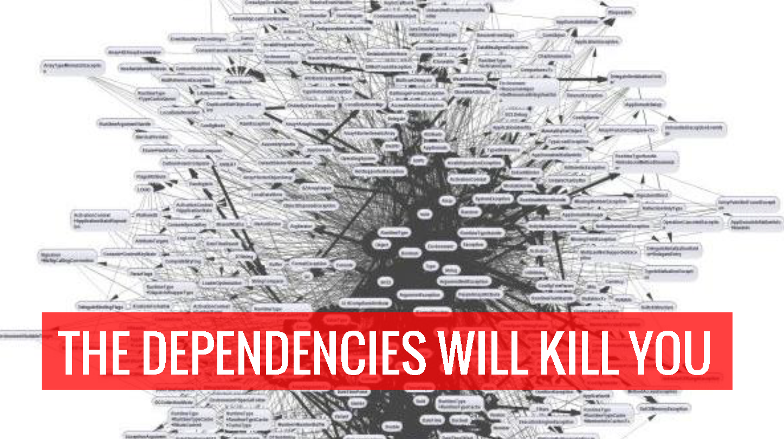

Slide 30
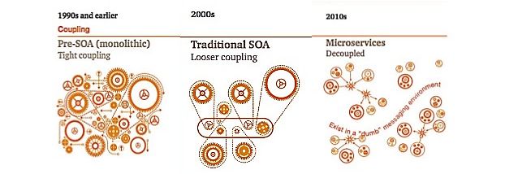
Microservices

Slide 31
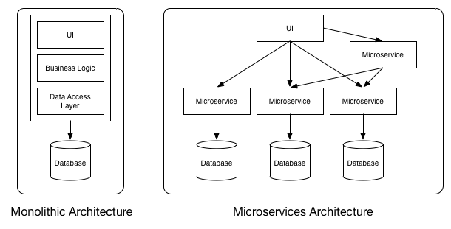
Microservices

Slide 32
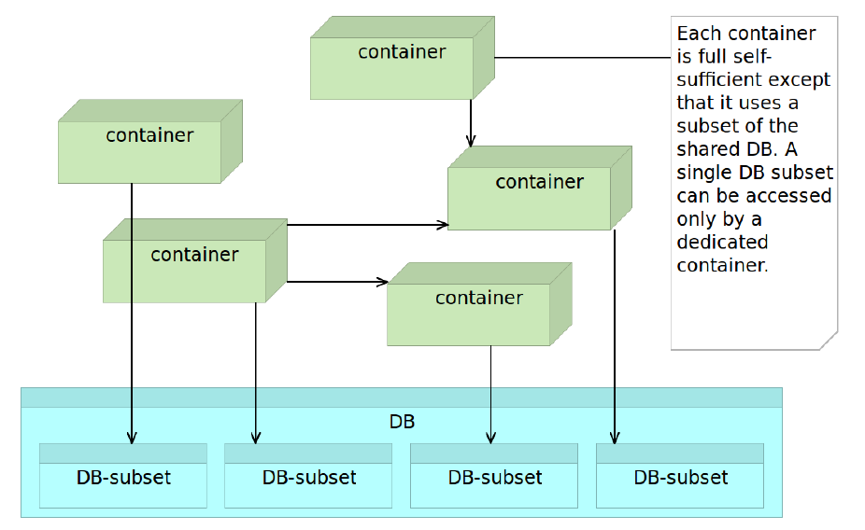
Microservices Accessing the Shared Database

Slide 33
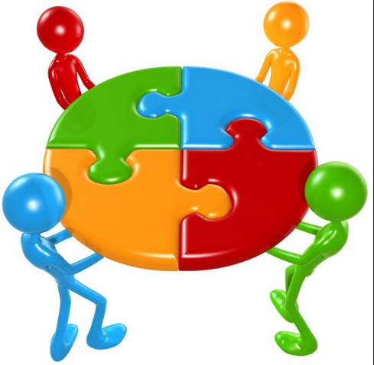
Microservices Characteristics
Many smaller (fine grained), clearly scoped services
Single Responsibility Principle
Independently Managed
Clear ownership for each service
Typically need/adopt the “DevOps” model

Slide 34
Service Discovery
100s of MicroServices
Need a Service Metadata Registry (Discovery Service)
Account Service
Registry
Service
Catalog
Service
Recommendation
Service
Customer Service
X
Service
Y
Service
Z
Service

Slide 35
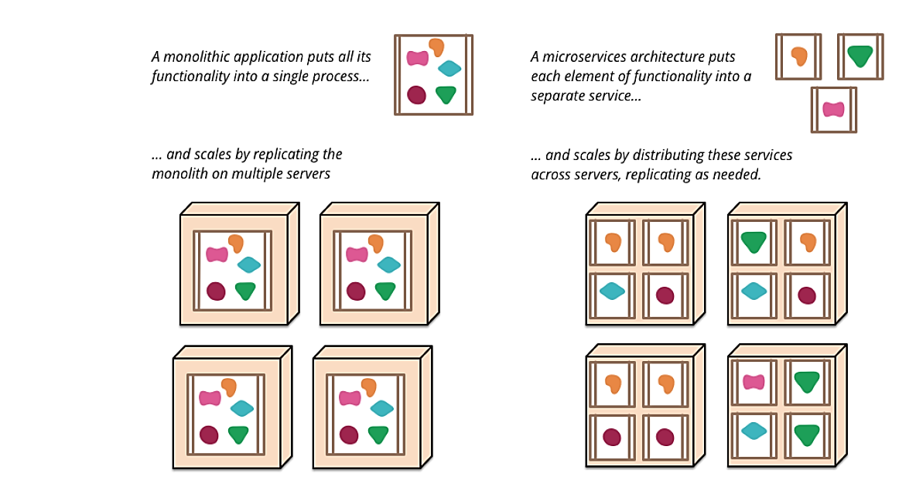
Microservices. Scalability

Slide 36
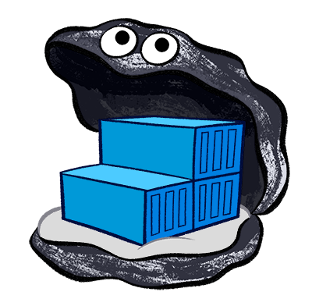
Docker

Slide 37
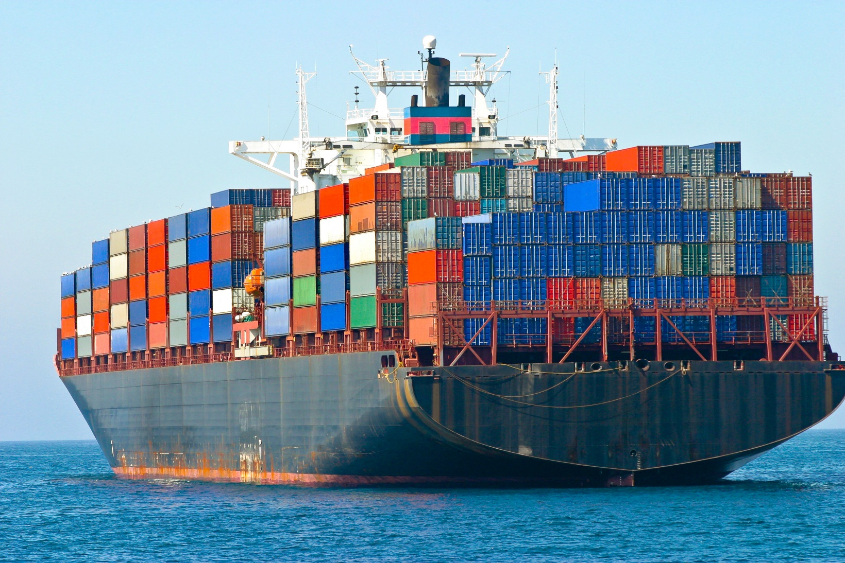
Docker: Containerization for Software

Slide 38
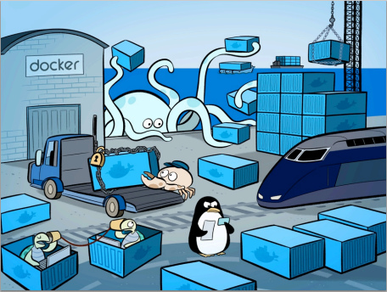
Docker
“Docker is an open platform for developers and sysadmins to build, ship, and run distributed applications”

Slide 39
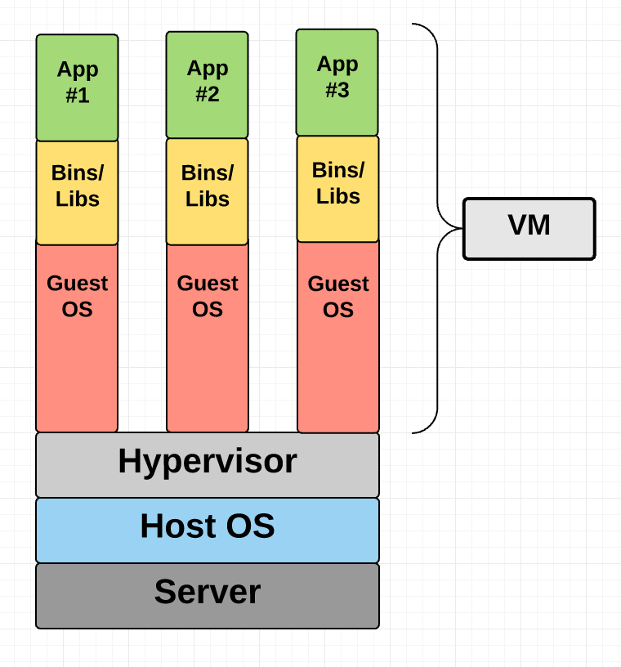
Virtual Machine

Slide 40
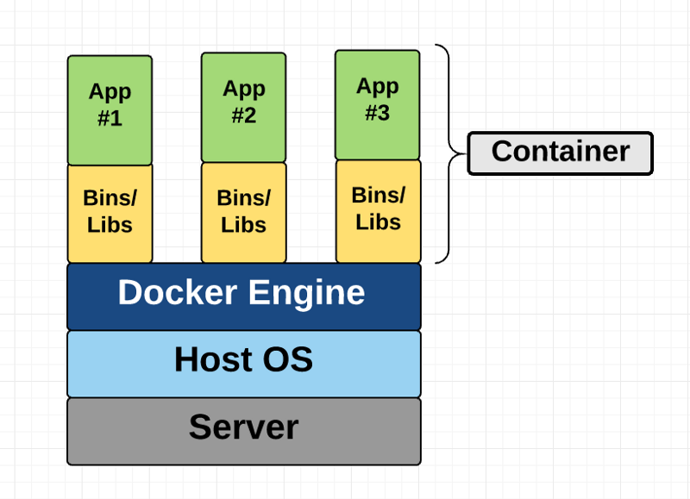
Container

Slide 41
So why Docker?
Containers are far from new;
Google has been using their own container technology for years.
Others Linux container technologies include
Solaris Zones,
BSD jails, and
LXC, which have been around for many years.
Docker is an open-source project based on Linux containers. It uses Linux Kernel features.

Slide 42
Docker Benefits
Local development environments can be set up that are exact replicas of a live environment/server.
It simplifies collaboration by allowing anyone to work on the same project with the same settings, irrespective of the local host environment.
Multiple development environments can be run from the same host each one having different configurations, operating systems, and software.
Projects can be tested on different servers.
It gives you instant application portability. Build, ship, and run any application as a portable container that can run almost anywhere.

Slide 43
Why Docker?
Ease of use. It allows anyone to package an application on their laptop, which in turn can run unmodified anywhere
The mantra is: “build once, run anywhere.”
Speed. Docker containers are very lightweight and fast. Since containers are just sandboxed environments running on the kernel, they take up fewer resources. You can create and run a Docker container in seconds, compared to VMs which might take longer because they have to boot up a full virtual operating system every time.
Docker Hub. Docker users also benefit from the increasingly rich ecosystem of Docker Hub, which you can think of as an “app store for Docker images.” Docker Hub has tens of thousands of public images created by the community that are readily available for use.
Modularity and Scalability. Docker makes it easy to break out your application’s functionality into individual containers. With Docker, it’s become easier to link containers together to create your application, making it easy to scale or update components independently in the future.

Slide 44
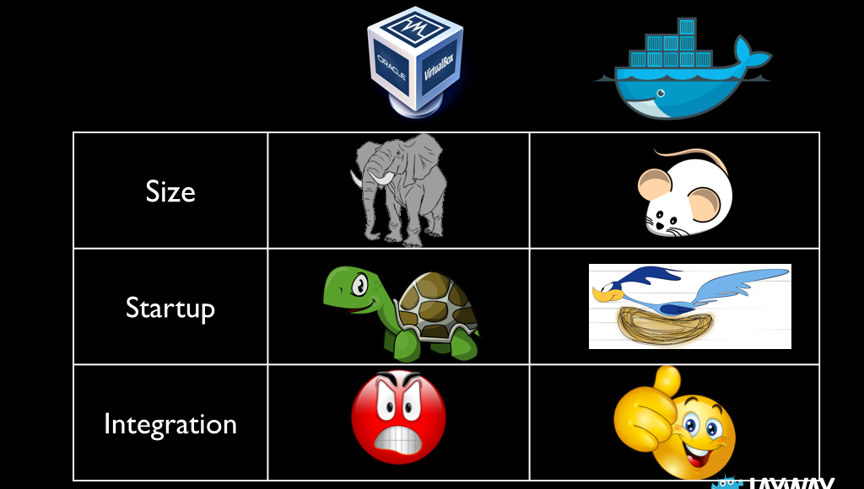
VM vs. Docker

Slide 45
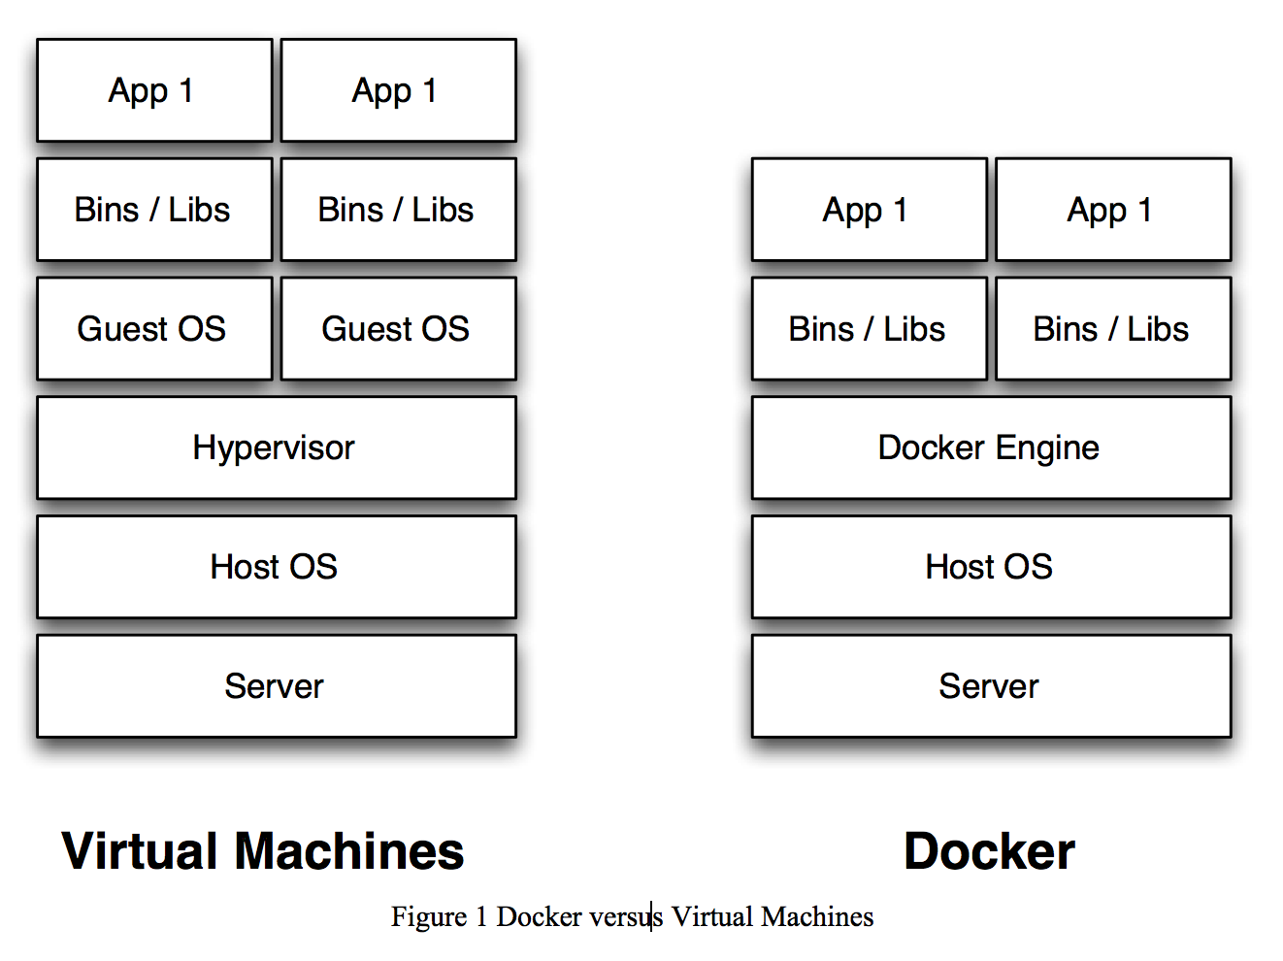
VM vs. Docker (Containers)
Docker Engine
Docker engine is the layer on which Docker runs.
It’s a lightweight runtime and tooling that manages containers, builds, and more.

Slide 46
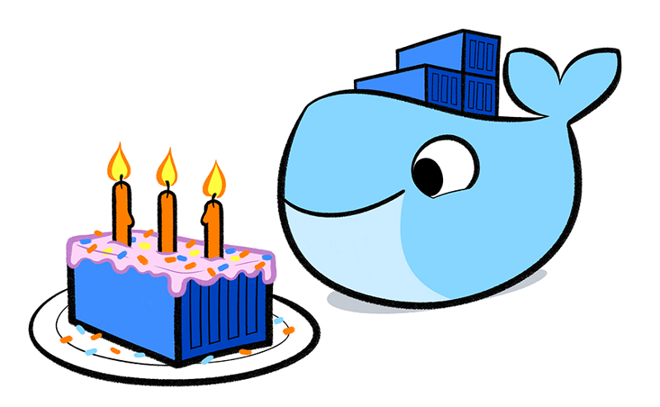
Gartner Hype Cycle

Slide 47
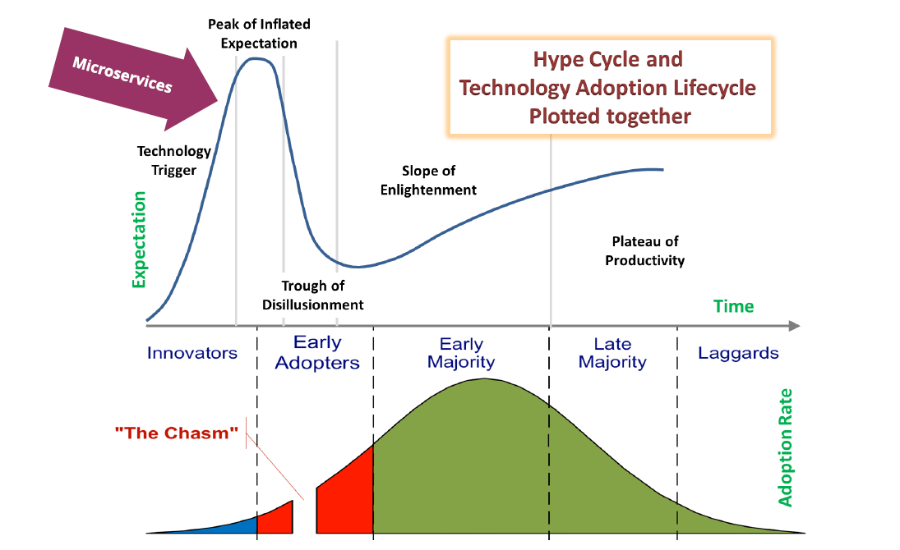
Gartner Hype Cycle

